Slide 1
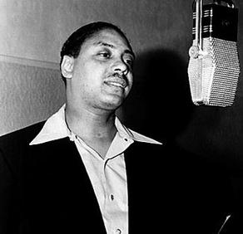
Big Joe Turner
Group 1
Sara Larson, Olivia Rezac, Hannah Weber, Brittney Whited

Slide 2
Shake, Rattle, and Roll

Slide 3
Shake, Rattle, and Roll- Lyrics
Get outta that bed, wash your face and hands Get outta that bed, wash your face and hands Well, you get in that kitchen, make some noise with the pots 'n pans Way you wear those dresses, the sun comes shinin' through Way you wear those dresses, the sun comes shinin' through I can't believe my eyes, all that mess belongs to you I believe to the soul you're the devil and now I know I believe to the soul you're the devil and now I know Well, the more I work, the faster my money goes I said shake, rattle and roll, shake, rattle and roll Shake, rattle and roll, shake, rattle and roll
Well, you won't do right to save your doggone soul Alright I'm like a one-eyed cat peepin' in a seafood store I'm like a one-eyed cat peepin' in a seafood store Well, I can look at you till you ain't no child no more Shake shake, rattle and roll, shake shake, rattle and roll Yeah yeah, rattle and roll, yeah yeah, rattle and roll You won't do nothin' to save your doggone soul Shake, rattle and roll roll roll roll

Slide 4
“Boss of the Blues”
Big Joe Turner was born May 18, 1911 in Kansas City, a city known for jazz and blues
As a young man, Turner was inspired by the buzzing city and so began his musical career, performing at clubs and cafes
When Turner met pianist Pete Johnson, the two of them introduced “boogie-woogie” and jump blues - a more upbeat style of blues music
[“Everybody was singing slow blues when I was young and I thought I’d put a beat to it and sing it uptempo.” - Big Joe Turner]
The duo rose to fame when they appeared at the “Spirituals to Swing” concert in New York City in December of 1938
In the 40s, Turner performed with various pianists and recorded with a multitude of labels

Slide 5
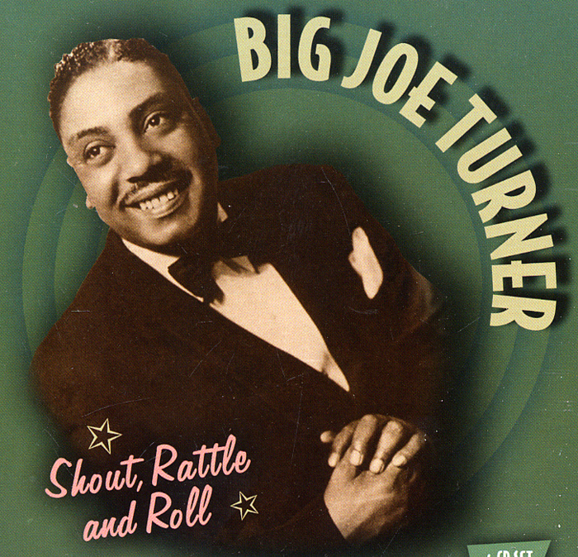
“Boss of the Blues”
In 1951, Turner was brought to Atlantic Records where he recorded numerous hits that are still played to this day
Although Turner was popular with the teenage audience, he was not limited and his recordings were a hit among many age categories
Because Turner was known for his combination of blues and rock & roll, when the rock and roll era began to die down, Turner returned to his blues roots
Big Joe Turner had established a timeless sound and continued performing and recording until his death in 1985

Slide 6
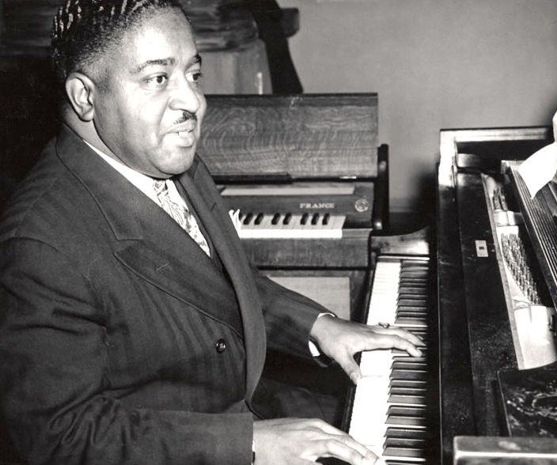
Musical Style - What Set Turner Apart
Jump Blues
Big Joe Turner was one of the first artists to mix slower rhythm & blues elements with swing and Boogie Woogie, a jazz style that uses only piano and is played at a much faster pace, making it easier for audiences can dance to it. Turner and his band added percussion and horns, but always made the piano the star.
“The result was Jump Blues, and Joe was its foremost practitioner.” - James Austin, Rhino Records
The progression of modern rock and roll can easily be traced back to the unique blend of these musical styles, starting with Big Joe

Slide 7
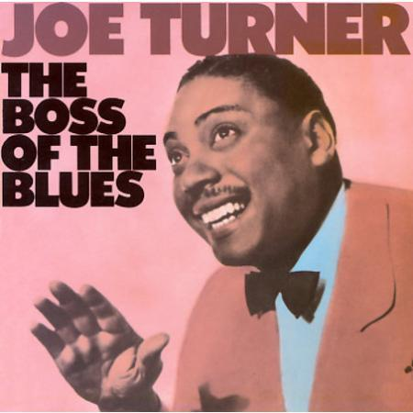
Influence the development of Rock & Roll
Big Joe Turner is considered the “Boss of the Blues”
He was the first artist to mix R&B with “boogie-woogie” to create a jump blues style - an upbeat style of blues music
This style of music is often considered to be the start of Rock & Roll

Slide 8
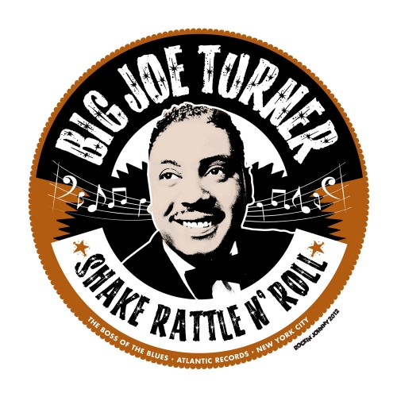
Influence on the development of Rock & Roll
His hit “Shake, Rattle, and Roll” is also considered to be the turning point into the Rock & Roll revolution
What made Big Joe Turner such a remarkable figure in the music industry was that he was able to touch on each popular genre during his time
Rhythm & Blues - Boogie Woogie - Rock & Roll
“Rock and roll would have never happened without him.” - Doc Pomus

Slide 9
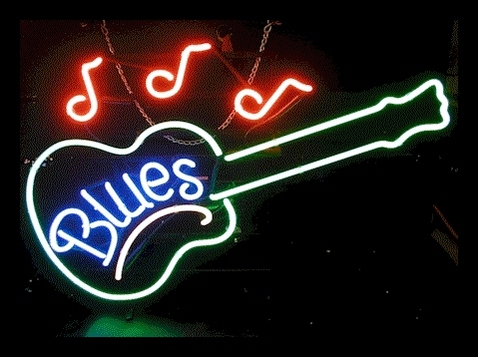
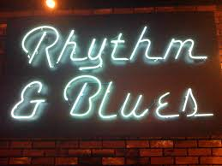
Music that influenced Big Joe Turner!

Slide 10
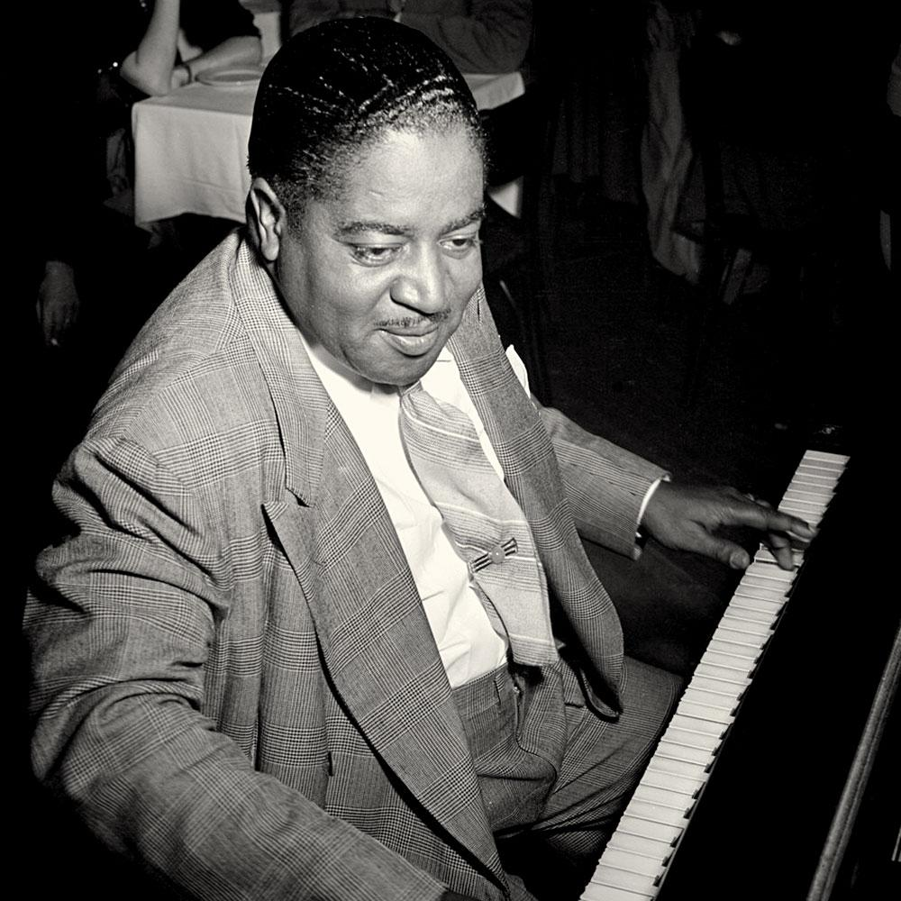
Musicians that inspired Big Joe Turner!
Count Basie
Andy Kirk
Jelly Roll Morton
Fats Waller
James P. Johnson
Meade “Lux” Lewis
Eubie Blake
Jimmy Rushing
Scott Joplin

Slide 11
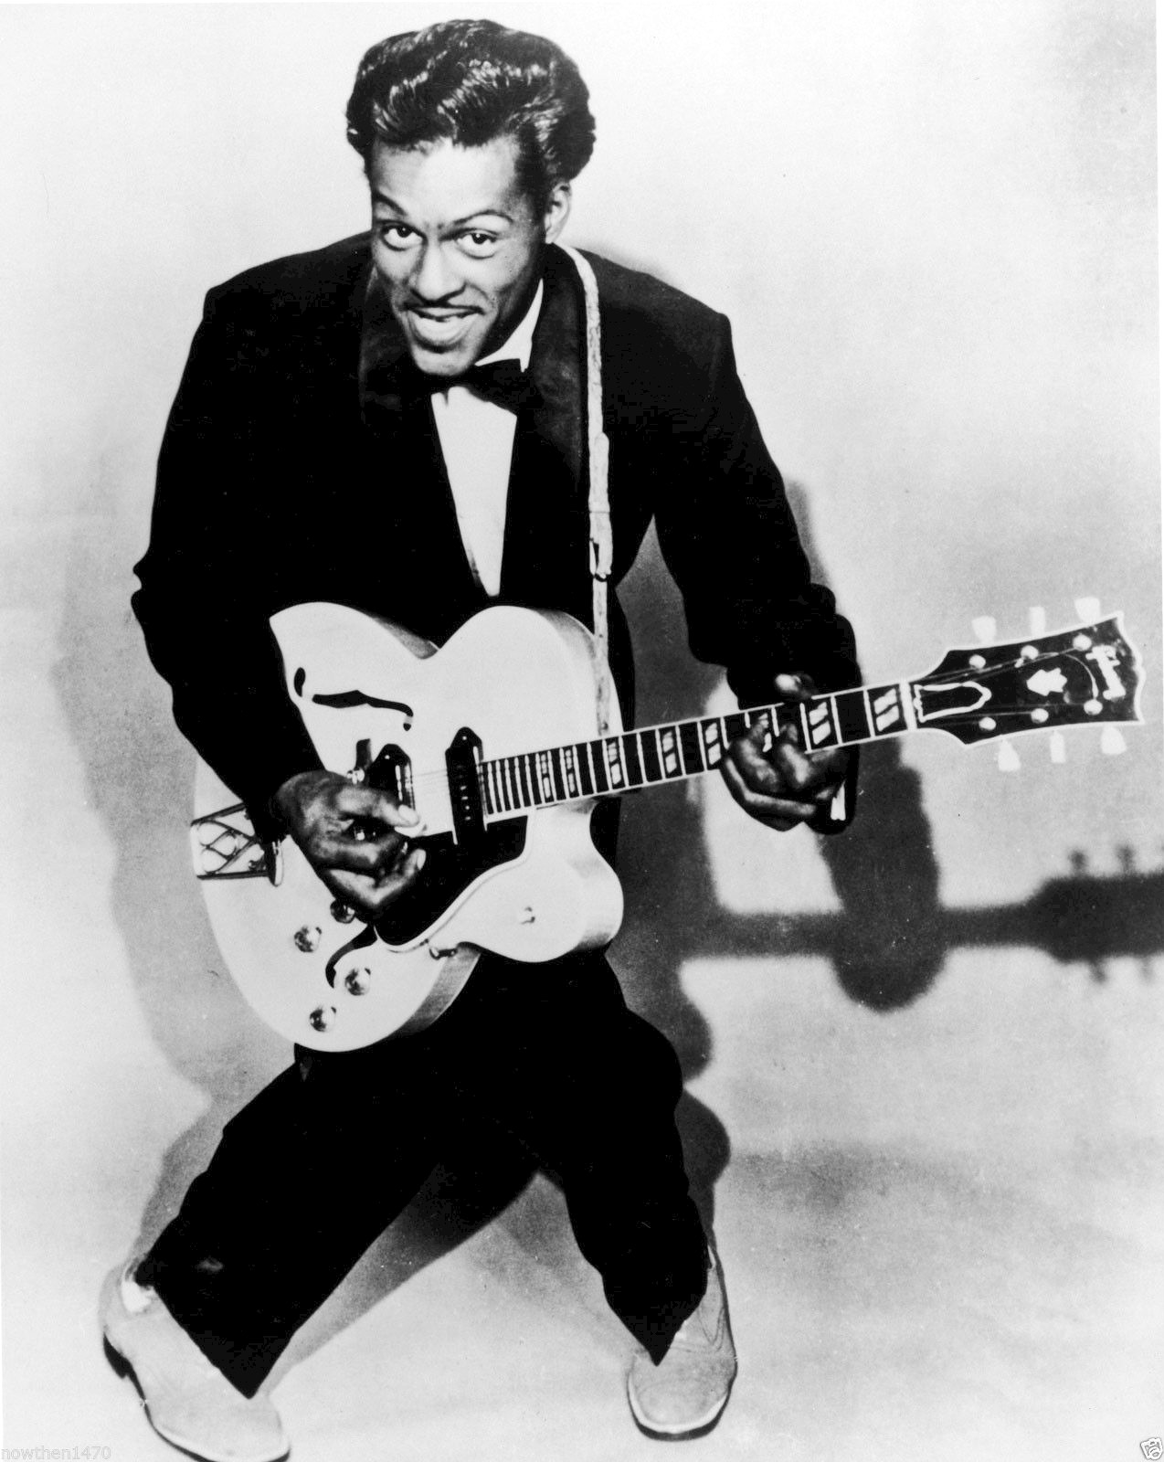
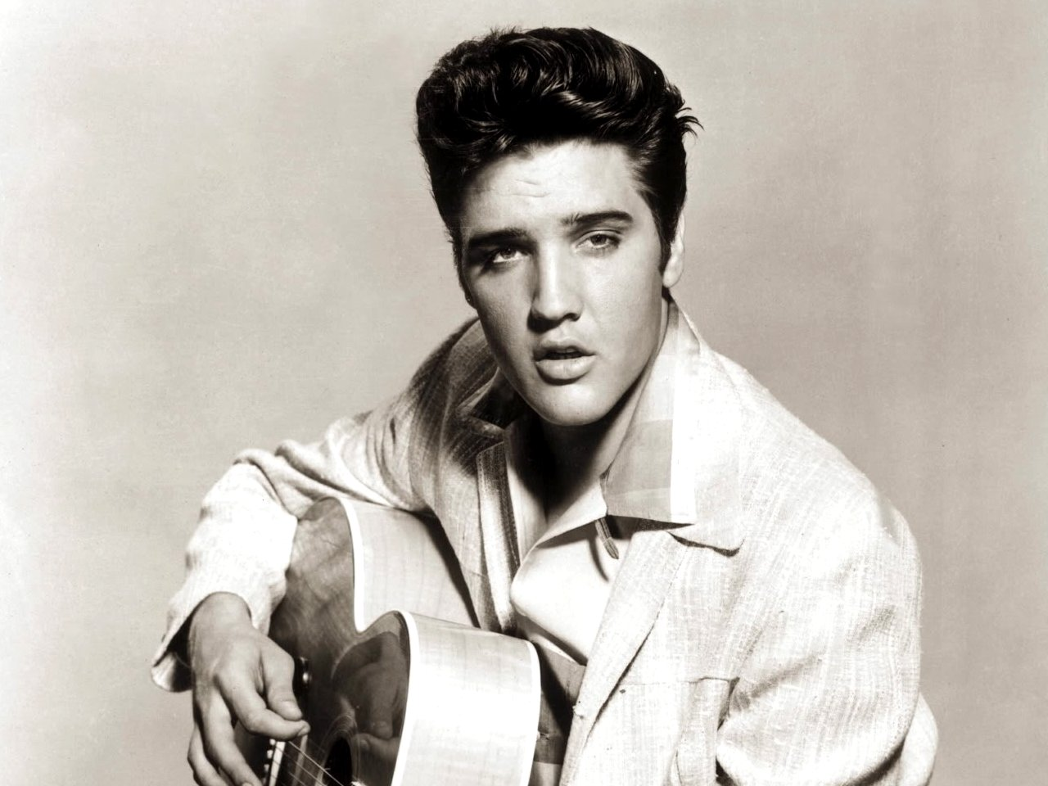
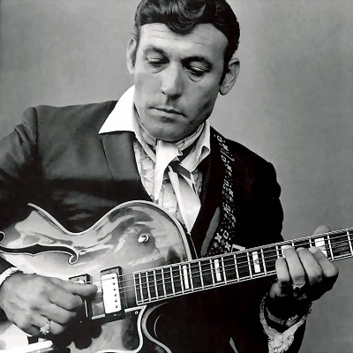
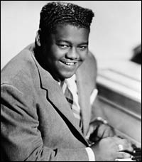
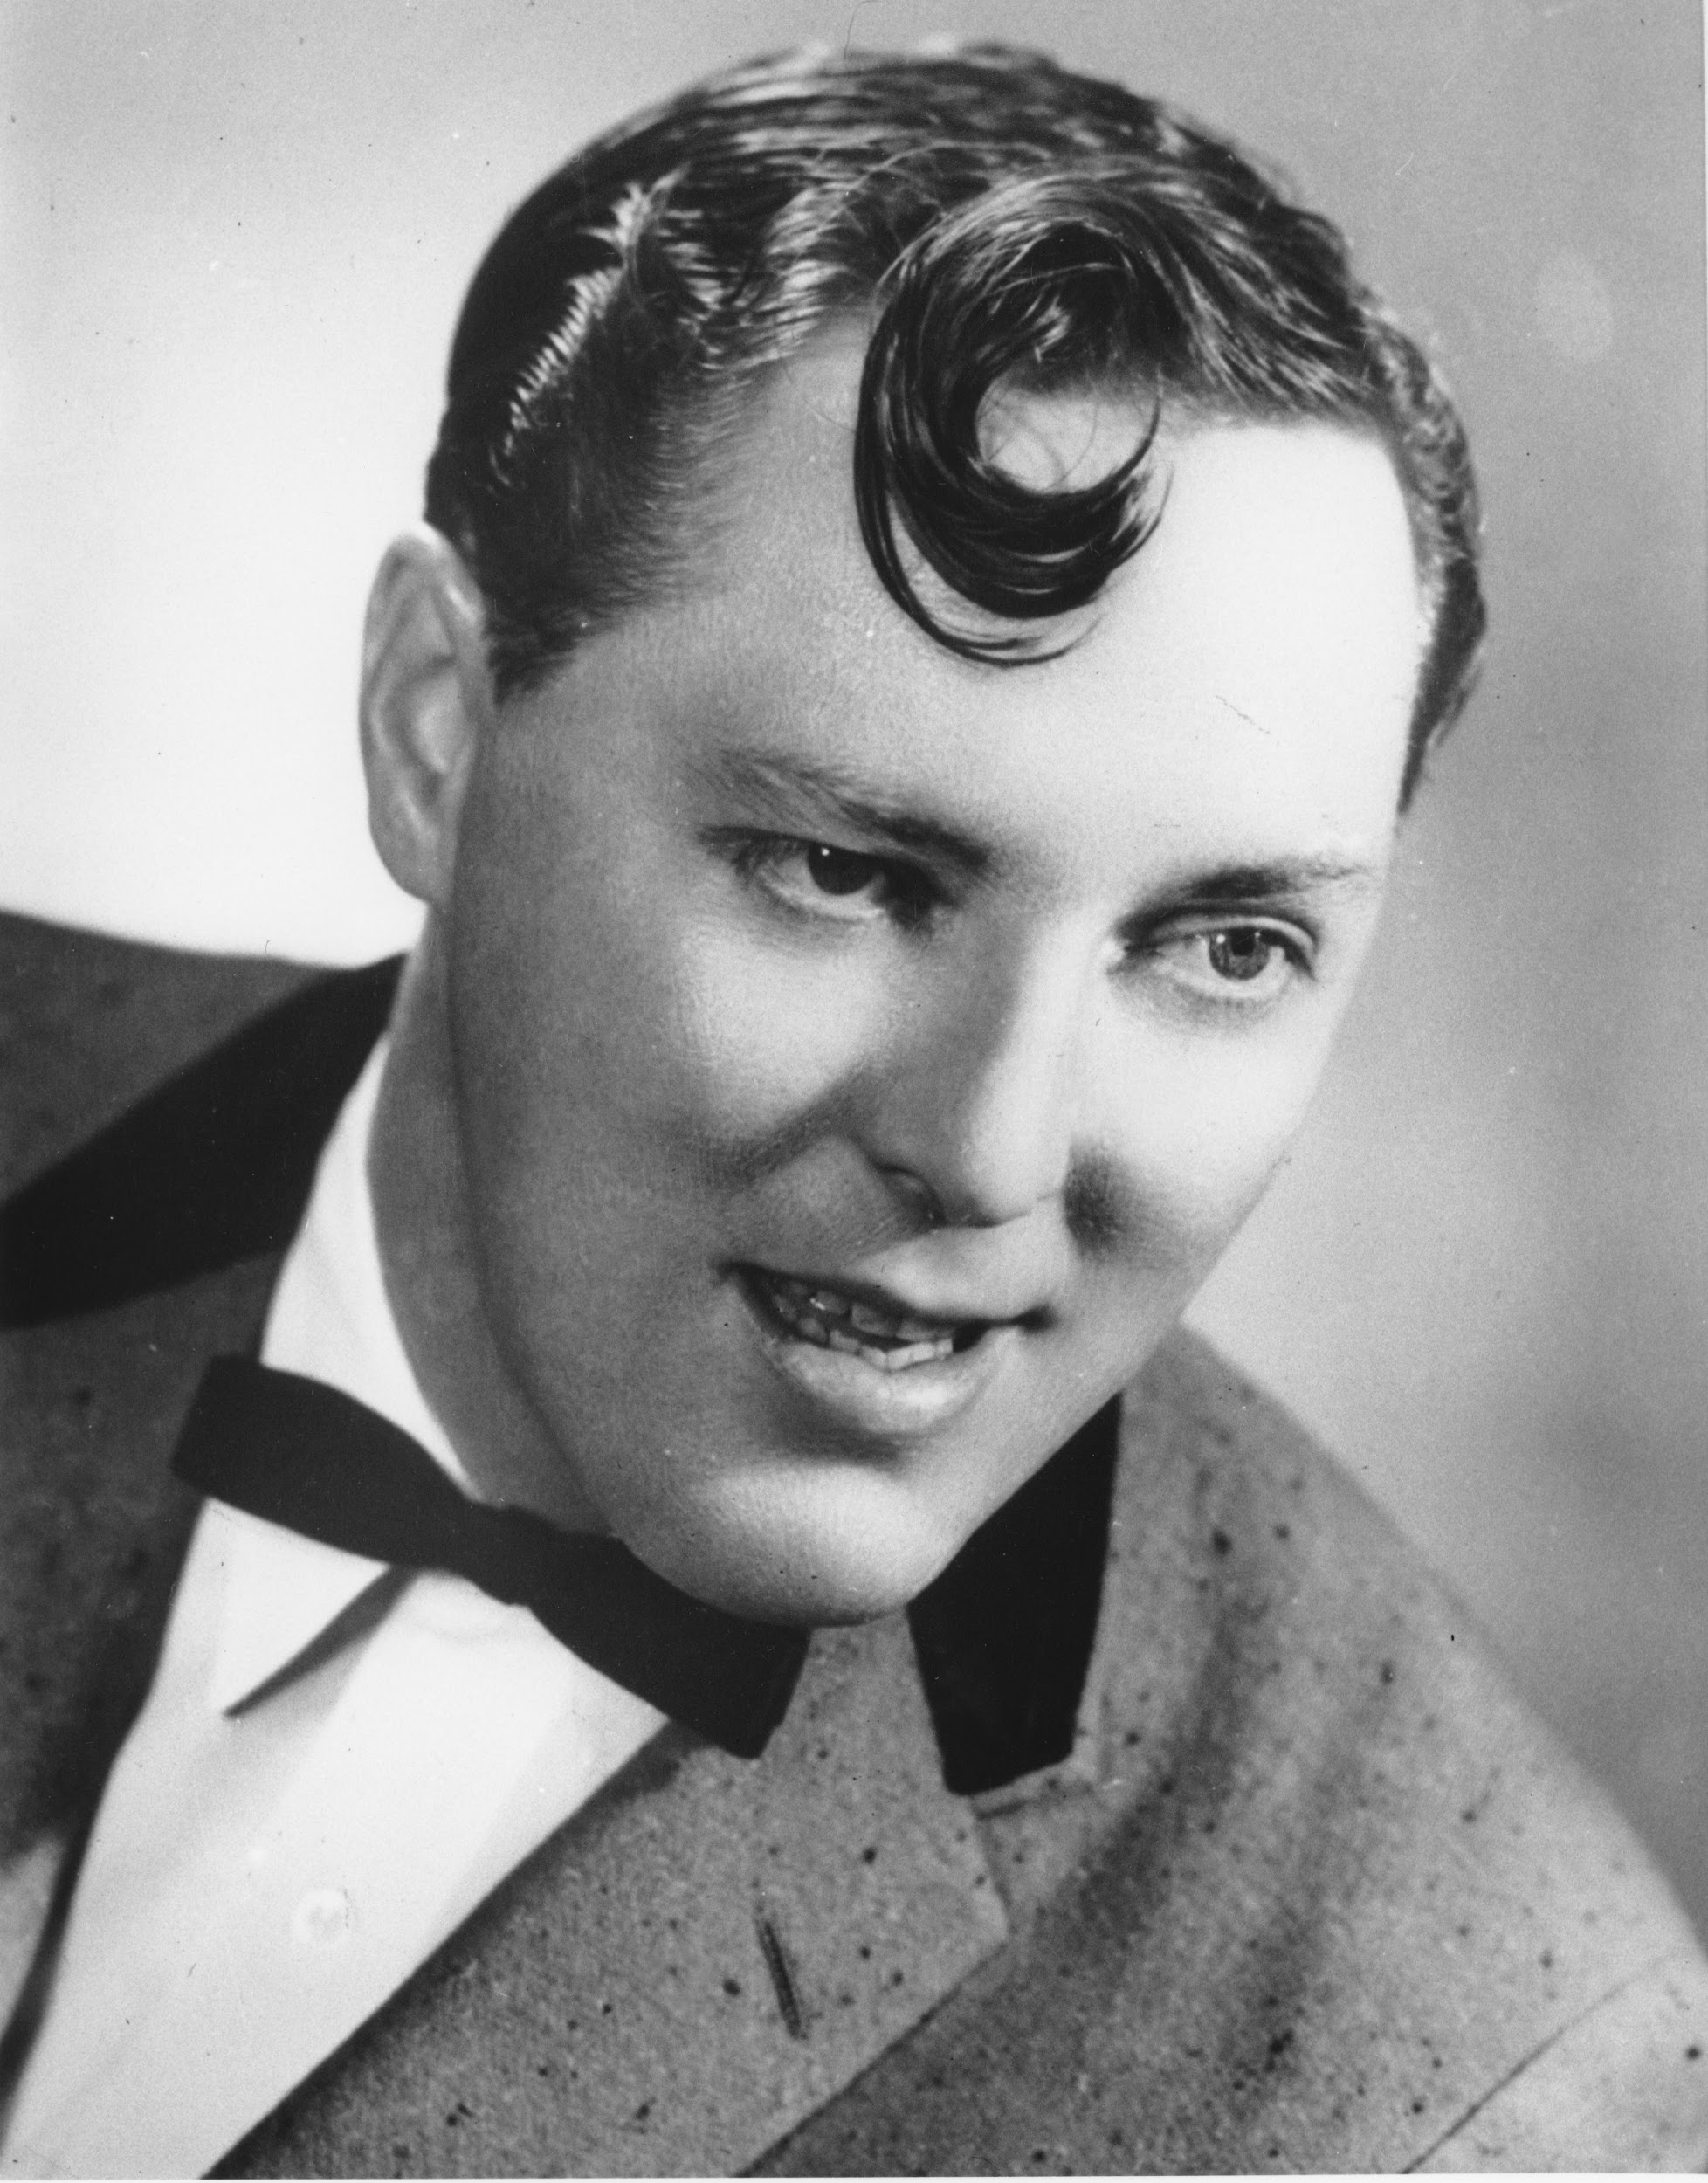
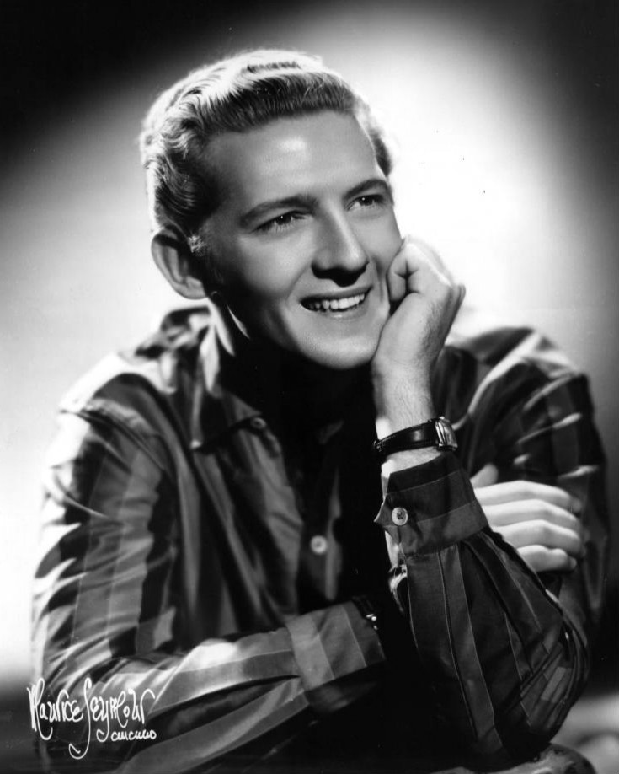
Who did Big Joe Turner influence?
Elvis Presley
Jerry Lee Lewis
Bill Haley
Chuck Berry
Carl Perkins
Fats Domino
And many more!

Slide 12
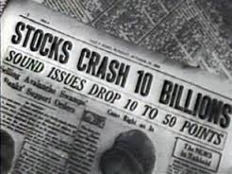
Music in the 1930’s- Events That Influenced Music in the 1930’s:
Stock Market Crash
The stock market crash inspired several artists to sing the blues or create songs that were hopeful for a recovery
Drought
In the 1930’s, an awful drought across the western United States eventually led to the Dust Bowl

Slide 13
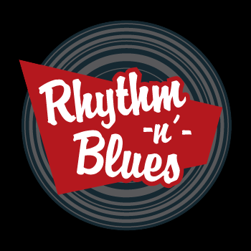
Events of the Time Period
Big Joe Turner was an artist during the rise
of Rhythm and Blues music
R & B music has a specific sound, featuring
the musical style of 12-bar blues
Big Joe Turner’s music followed suit, and his
songs followed the same style and structure of
other rhythm and blues music

Slide 14
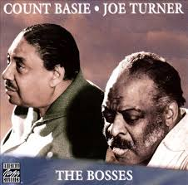
Count Basie
Count Basie was a jazz musician, particularly on the piano during Big Joe Turner’s time period
Basie enjoyed the blues as well, and he would often take the most famous blues players of his time and put them in a showcase
In 1973, Basie and Big Joe Turner worked together to create the album The Bosses

Slide 15
References
The Rock and Roll Hall of Fame Museum. (n.d.). Retrieved June 19, 2016, from https://rockhall.com/inductees/big-joe-turner/bio/
About.com. (2013). History 1900's. Retrieved from http://history1900s.about.com/od/timelines/tp/timeline.htm
All Music (2016). Retrieved June 19, 2016, from http://www.allmusic.com/album/the-bosses-mw0000674645

